Slide 1


Health Economics Lecture #7
Topic: An Introduction to Health Technology Assessment and Economic Evaluation
Prepared by Jacob Smith, Trent University

Slide 2
Learning Objectives
In this lecture we will discuss:
An Overview of Economic Evaluation.
An Overview of Model Structures: Decision Trees and Markov Models.
CMA, CEA, CUA, CBA and the ICER
Goal of this Lecture:
Introduce economic evaluation in health.
Understand the role of economic evaluation in the decision to fund novel treatments.

Slide 3
An Overview of Economic Evaluation

Slide 4
What is Economic Evaluation
Economic evaluation is the process of systematic identification, measurement and valuation of the inputs and outcomes of two alternative activities, and the subsequent comparative analysis of these. -Drummond, Michael; Sculpher, Mark; Torrance, George; O'Brien, Bernie; Stoddart, Greg (2005). Methods for the Economic Evaluation of Health Care Programmes (3 ed.)
In the context of health, economic evaluation is used to determine if it makes sense to pay for or fund new drugs and medical technologies.
Because of this, economic evaluation has played a role in both assessing the value of new medical technologies and marketing them.

Slide 5
Economic Evaluation and The Life Cycle of a Drug
Price
Clinical Trials Phase I
Registration
Pharmacology
Phase II
Drug surveillance
Chronical toxicity
Acute Toxicology
Phase III
Patent filed
Discovery
Patent Expires
Time
Research
10 years
Administration
20 years
15 years

Slide 6
Economic Evaluation and The Life Cycle of a Drug
Economists Work Here!
Price
Clinical Trials Phase I
Registration
Pharmacology
Phase II
Drug surveillance
Chronical toxicity
Acute Toxicology
Phase III
Patent filed
Discovery
Patent Expires
Time
Research
10 years
Administration
20 years
15 years

Slide 7
Who does Economic Evaluation?
Economic Evaluation is often used to tell a story of if a drug is cost effective. Meaning: “does this new drug more effective and/or cheaper than current treatments on the market”.
Often Drug R&D firms will submit Economic Evaluations to governments or 3rd party payers (i.e. insurance companies) when applying for funding.
Because of this “marketing” aspect of economic evaluation assessors must carefully review submitted results and model structures to see if their assessment is accurate.
Still, a large majority of economic evaluation work is done by independent researchers.

Slide 8
An Overview of Model Structures: Decision Trees and Markov Models.

Slide 9
Model Structures
To conduct an economic evaluation of a health intervention knowledge of the clinical pathway and risks faced by patients is required.
There are two main model structures which will be analyzed here are:
Decision Tree Models.
Cohort/Markov Models.
The model centric approach, tells us about the timing and sequence that costs and benefits are realized.
There are other model structures used in economic evaluation (such as microsimulations) but their discussion is beyond the scope of this course.
NOTE: We will not discuss how to compute these models (this is saved for next class)

Slide 10
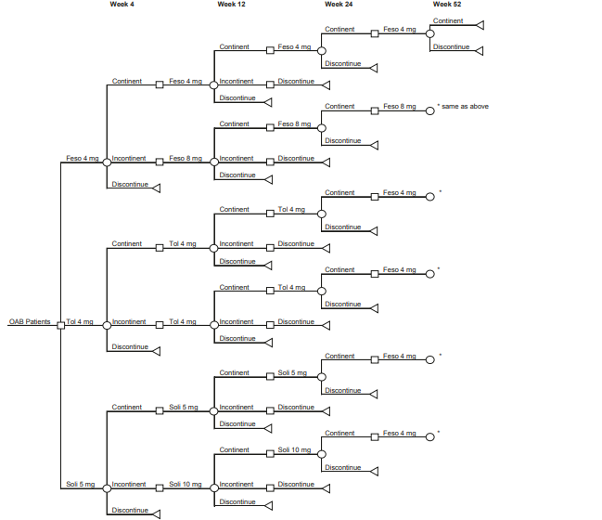
Decision Tree Models
Decision trees are visual representations of the choice environment seen from the perspective of medical decision makers treating patients.
As a Style guide:
Squares represent “decision nodes”.
Circles represent “chance nodes”
Triangles represent “Terminal Nodes”
Branches tell us the possible paths to different outcomes.
Decision tree model from: Arlandis-Guzman, S., Errando-Smet, C., Trocio, J., Arumi, D., & Rejas, J. (2011).

Slide 11
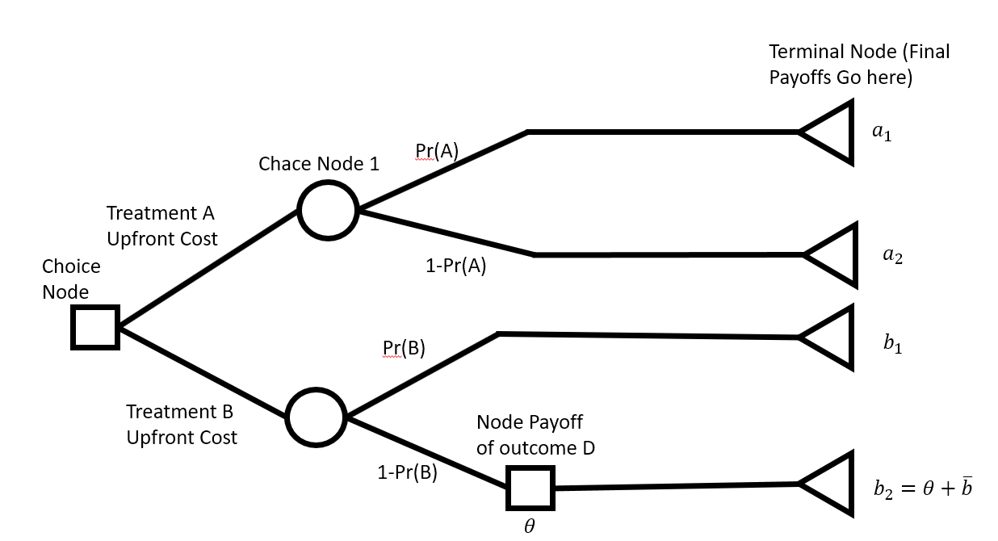
Some Rules for Decision Tree Design
In terms of a “Theory of Decision Trees” there's not a lot to know but there are some rules.
Rule #1: Decision Nodes Should not come after chance nodes if an initial decision has already been made (Best Response Principle).
[NOTE: Any decision node that comes after a chance node has a single branch].
Rule #2: If a chance node occurs before the a time when an initial decision must be made and the state of the world is observable a decision is not made until this uncertainty is resolved. (Kreps’ Fundamental Rule for Decision Trees)

Slide 12

Decision Trees as Expected Value
Decision trees are graphical representations of expected value equations.
As an Example: Suppose a doctor can treat a sick patient with two different drugs. Drug A has a 50% chance of curing the patient with no side effects a 20% chance of curing the patient with side effects and a 30% chance of doing nothing. Drug B has a 80% chance of curing the patient with side effects and 20% chance of doing nothing
0.5
Cured+No Side Effects
0.2
$$EV_{A}=0.5u\left(C_{NSE}\right)+0.2u\left(C_{SE}\right)+0.3u(Sick)$$
Drug A
Cured+Side Effects
0.3
Nothing
0.8
Cured+Side Effects
$$EV_{B}=0.8u\left(C_{SE}\right)+0.2u(Sick)$$
Drug B
0.2
Nothing

Slide 13
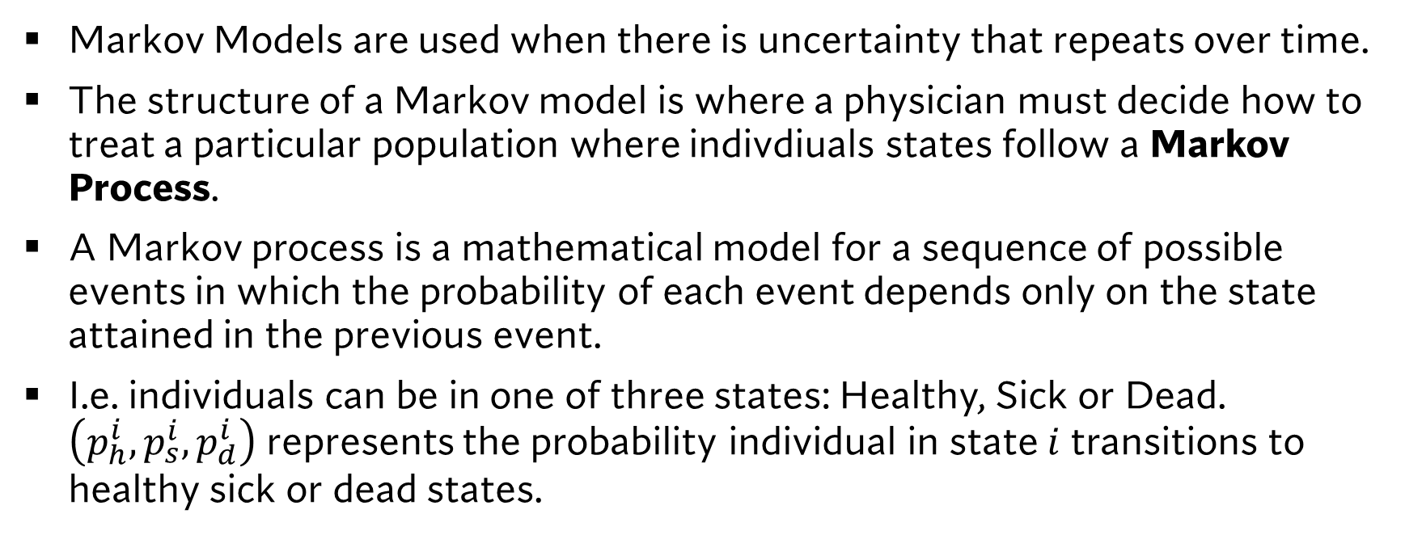
Markov Models
Markov Models are used when there is uncertainty that repeats over time.
The structure of a Markov model is where a physician must decide how to treat a particular population where indivdiuals states follow a Markov Process.
A Markov process is a mathematical model for a sequence of possible events in which the probability of each event depends only on the state attained in the previous event.
I.e. individuals can be in one of three states: Healthy, Sick or Dead. $\left(p_{h}^{i},p_{s}^{i},p_{d}^{i}\right)$ represents the probability individual in state $i$ transitions to healthy sick or dead states.

Slide 14
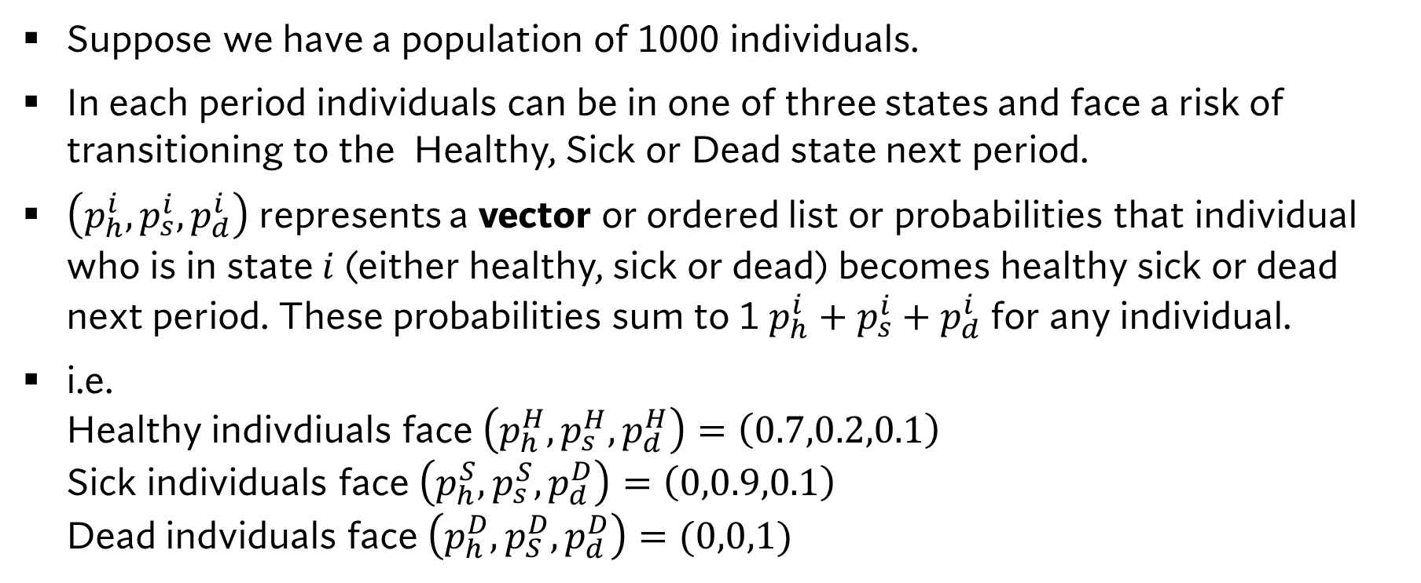
Markov Process Example:
Suppose we have a population of 1000 individuals.
In each period individuals can be in one of three states and face a risk of transitioning to the Healthy, Sick or Dead state next period.
$\left(p_{h}^{i},p_{s}^{i},p_{d}^{i}\right)$ represents a vector or ordered list or probabilities that individual who is in state $i$ (either healthy, sick or dead) becomes healthy sick or dead next period. These probabilities sum to 1 $p_{h}^{i}+p_{s}^{i}+p_{d}^{i}$ for any individual.
i.e. Healthy indivdiuals face $\left(p_{h}^{H},p_{s}^{H},p_{d}^{H}\right)=\left(0.7,0.2,0.1\right)$ Sick individuals face $\left(p_{h}^{S},p_{s}^{S},p_{d}^{D}\right)=\left(0,0.9,0.1\right)$ Dead indviduals face $\left(p_{h}^{D},p_{S}^{D},p_{d}^{D}\right)=(0,0,1)$

Slide 15

Markov Process Example:
We orient this in the context of a matrix: $\left[\begin{matrix}p_{h}^{H} & p_{s}^{H} & p_{d}^{H} \\ p_{h}^{S} & p_{s}^{S} & p_{d}^{S} \\ p_{h}^{D} & p_{s}^{D} & p_{d}^{D}\end{matrix}\right]=\left[\begin{matrix}0.7 & 0.2 & 0.1 \\ 0 & 0.9 & 0.1 \\ 0 & 0 & 1\end{matrix}\right]$
Graphically we can represent this model as:
Note: In this context the Dead state is called the ABSORBING STATE as it is the state where all individuals will end up if the model is simulated long enough.
0.9
Sick
0.7
0.2
0.1
1
Healthy
Dead
0.1

Slide 16
On Computing Markov Models
Computing Markov Models requires some matrix multiplication and defining of what our initial cohort size and distribution of states are.
This is beyond the scope of this lecture.
I have linked some resources on Markov models if you are interested in computing them
ALL YOU NEED TO KNOW IS THAT THE WAY OUTCOMES MAY BE CALCULATED ARE ACCORDING TO THIS PROCESS

Slide 17
Markov Models VS Decision Trees
Decision makers are still making a choice between treatment options however their choice faces a complex risk structure.
Medical decision making is complex and often one model can make more sense to use compared to another.
While there are no set rules, the choice of model often depends on the horizion of analysis and if repeated events are possible.
Short time horizions are more permitting of decision tree models over Markov models.
While repeated events can be accommodated in a decision tree framework, it becomes both graphically and computationally cumbersome to work with them.

Slide 18
Types of Analysis: CMA, CEA, CUA and CBA.

Slide 19
Analysis type
The purpose of economic evaluation and health technology assessment is to determine if the adoption of new technology (or the continued funding of older technology which is already in place) is efficient.
There are several ways of doing this:
Demonstrating a cheaper alternative which produces the same patient outcomes (Cost Minimization Analysis).
Demonstrate a new treatment is more effective and less costly in reaching some clinically relevant target-lower blood pressure, stress, heart attack risk (Cost Effectiveness Analysis).
Demonstrate a new treatment produces a higher quality of life at a lower cost compared to other treatments (Cost Utility Analysis).
Demonstrate a new treatment produces a “dollar valued” quality of life at a lower cost compared to other treatments (Cost Benefit Analysis).

Slide 20
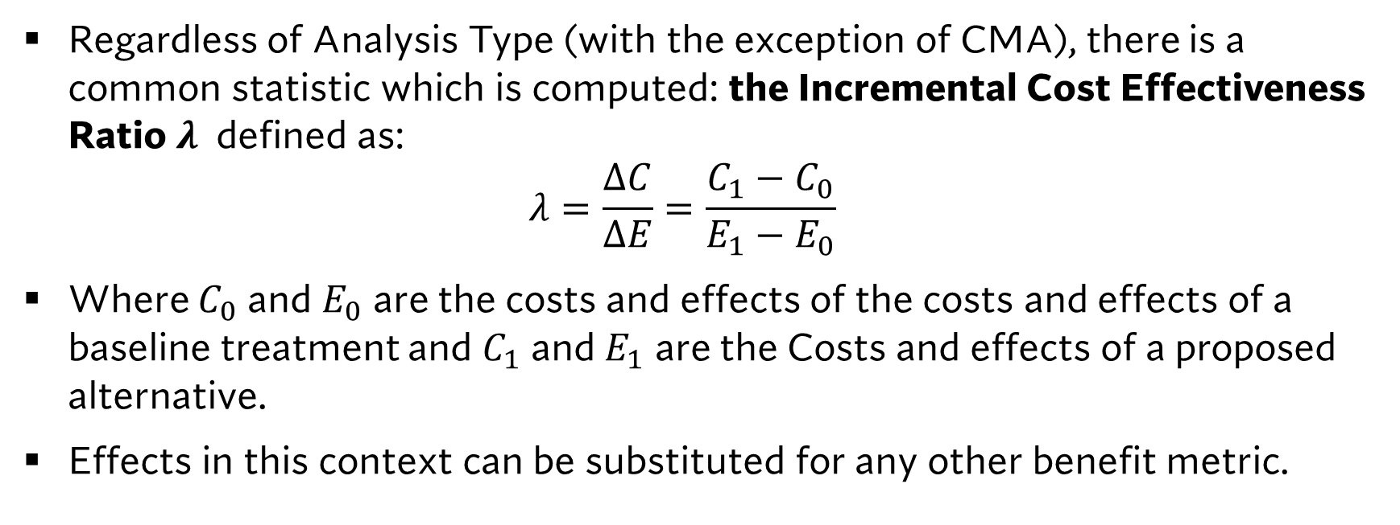
The ICER
Regardless of Analysis Type (with the exception of CMA), there is a common statistic which is computed: the Incremental Cost Effectiveness Ratio $λ$ defined as: $λ=\frac{ΔC}{ΔE}=\frac{C_{1}−C_{0}}{E_{1}−E_{0}}$
Where $C_{0}$ and $E_{0}$ are the costs and effects of the costs and effects of a baseline treatment and $C_{1}$ and $E_{1}$ are the Costs and effects of a proposed alternative.
Effects in this context can be substituted for any other benefit metric.

Slide 21
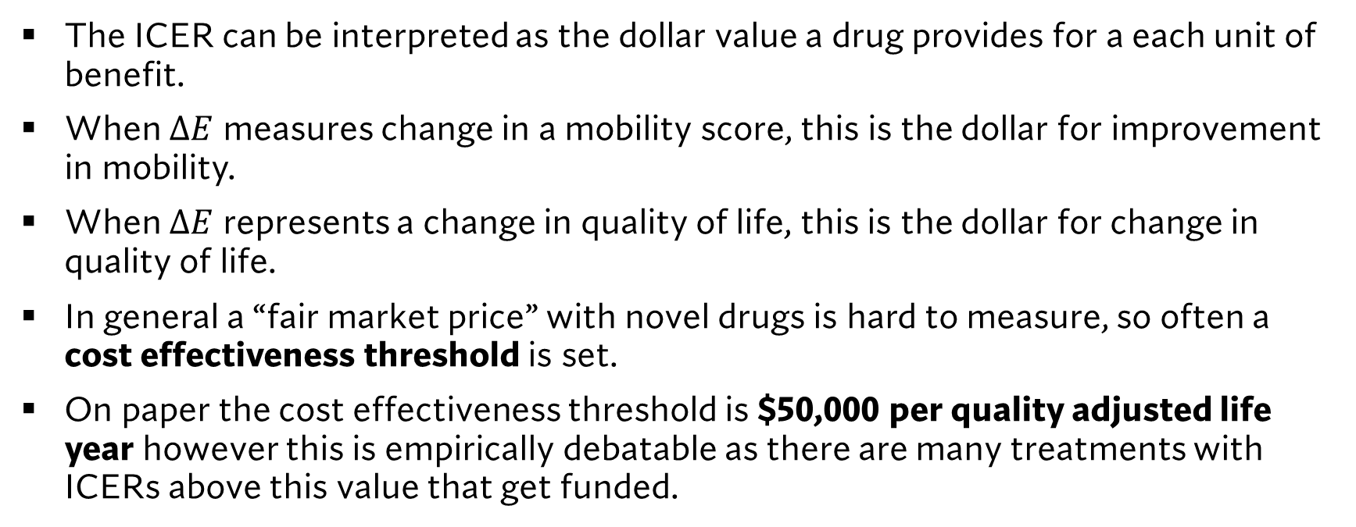
How to use the ICER
The ICER can be interpreted as the dollar value a drug provides for a each unit of benefit.
When $ΔE$ measures change in a mobility score, this is the dollar for improvement in mobility.
When $ΔE$ represents a change in quality of life, this is the dollar for change in quality of life.
In general a “fair market price” with novel drugs is hard to measure, so often a cost effectiveness threshold is set.
On paper the cost effectiveness threshold is $50,000 per quality adjusted life year however this is empirically debatable as there are many treatments with ICERs above this value that get funded.

Slide 22
Learning Objectives
In this lecture we will discuss:
An Overview of Economic Evaluation.
An Overview of Model Structures: Decision Trees and Markov Models.
CMA, CEA, CUA, CBA and the ICER
Goal of this Lecture:
Introduce economic evaluation in health.
Understand the role of economic evaluation in the decision to fund novel treatments.

